Slide 1
Data tools for Data Professionals
DSX & Spark Overview
Notes:
Any data professionals?
Quick round table of who you are and what you do ….
Great! How many of you have heard of spark? Used spark?

Slide 2
Agenda
DSX Overview
Spark Overview
Hands on Labs (Technical)
Develop familiarity with the platform
Learn to deploy end-end applications with the platform
Notes:
Hands on labs will be in spark, and we will put into practice what we have gone over…
We have 3 labs and I normally give the room about 45 min- hour to do each lab....

Slide 3

Data Science Experience
Notes:
Since our platform is named Data Science Experience , the primary user is a data scientist

Slide 4

What is data science?
Notes:
It Is an interdisciplinary field
It sits at the intersection of quite a few skill sets
While Machine learning & Data Science are closely related, data science differentiates itself by also requiring domain knowledge.
For example, you may have some background in genomics and when presented with such a set, you apply what you know to convert your data into something which machine learning models can use, we will see a small example of this later on during our labs
And while it is indeed a wide set of skills to be mastered, good news for us is that a lot of tools out there abstract away all the nitty gritties of these skills
All you need to know is the uses of each and how and where to apply them. We will see a some examples later on in our hands on lab

Slide 5
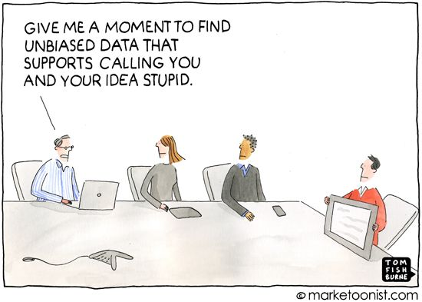
Why do we need it?
We need Data Science to make valid, objective inferences from data, free from human bias – KDNuggets
Notes:
We need data science to be able to answer business questions
You want to be able to know if the KPIs you have defined for your business and are looking good are a result of your marketing efforts or some external factors.
More concisely, you want to be able to make decisions based on something solid and not just because your gut says so.
KDNuggets

Slide 6
What do we need to practice data science?
Technology / Technology stack
Platform / Tool(s)
Data
Expertise
Notes:
Take polls around the room for each of these!
1) Data Scientists, what do you use to code?
2) What kind of platforms do you use? (code editors, git, etc)
3) How much data do you think you churn through on a daily basis?
The 4 things up on this slide can be filled with a combination of your replies, and most of the times, selecting what goes in here depends on your preference.

Slide 7
What do we need to practice data science?
Technology / Technology stack
Python, Spark (SQL, Machine learning)
Platform / Tool(s)
Data Science Experience (contains the set of tools useful for a team)
Data
Kaggle
Expertise
Analysts, Data Scientists, Data Engineers, Application Developers
Notes:
I have chosen a set of tools to work with, hopefully that is not too many
We will be working with these during our hands on labs
These could easily have been any of the things you guys just talked about. But, with the choice of tools, also comes issues…

Slide 8

Data Scientist - Current Challenges and Pain Points
Rigid toolset
Difficult to navigate between the various tools used
Fragmented and time consuming
Using multiple disjoint environments
Separate on-ramp/community for each tool/environment
Analytical Silo
Difficult to maintain and version control project assets
Notes:
We tried to highlight points which elongated “Time to Live “ in projects within business ….
Rigid toolset
Specially with different personas
Fragmented & time consuming….

Slide 9



Data Science Experience
Learn
Create
Collaborate
Built-in learning to get started or go the distance with advanced tutorials
The best of open source and IBM value-add to create state-of-the-art data products
Community and social features that provide meaningful collaboration
http://datascience.ibm.com
Notes:
DSX is a single platform to Learn, Create, and Collaborate – the 3 pillars of a successful data science organization.
Learn: Learn from each other & develop new skills
Create: Create projects in the environment of your choice
Collaborate: Within your organization with your colleagues and outside with other data professionals(you even chat with data scientists from IBM).

Slide 10
Core Attributes of the Data Science Experience
IBM Data Science Experience
Community
Open Source
IBM Added Value
Find tutorials and datasets
Connect with Data Scientists
Ask questions
Read articles and papers
Fork and share projects
Code in Scala/Python/R/SQL
Jupyter Notebooks
RStudio IDE and Shiny
Apache Spark
Your favorite libraries
IBM Machine Learning*
SPSS Modeler Canvas*
Prescriptive Analytics - DOcplexcloud
Projects and Version Control
Managed Spark Service
Powered by IBM Watson Data Platform
* Closed beta
Notes:
If I want to summarize the platform in one-slide, I would say it is a combination of social, open source and value add features, and we are going to demonstrate a few of these today…

Slide 11
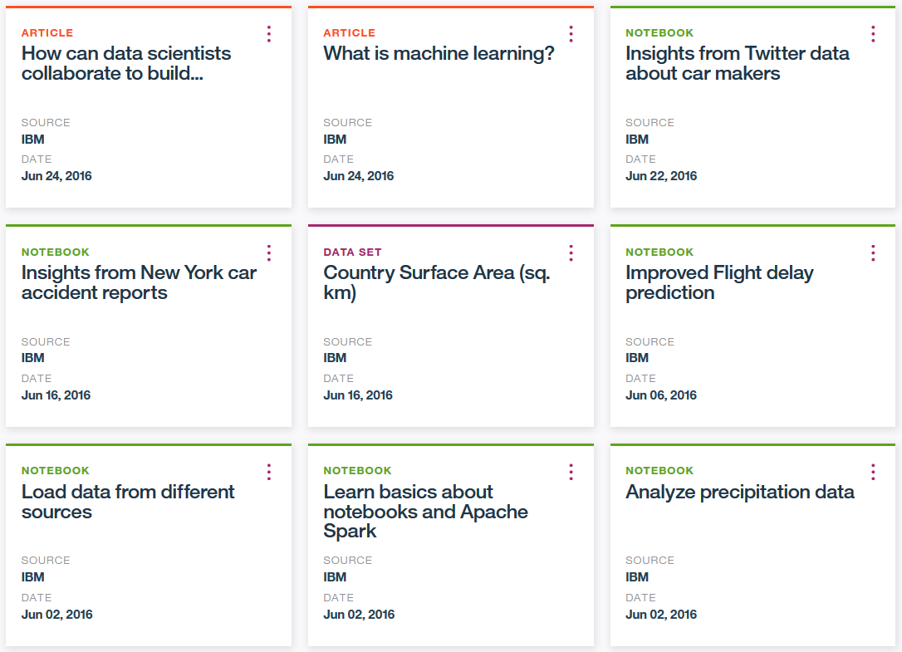
Community Cards provide in-context learning for users

Slide 12
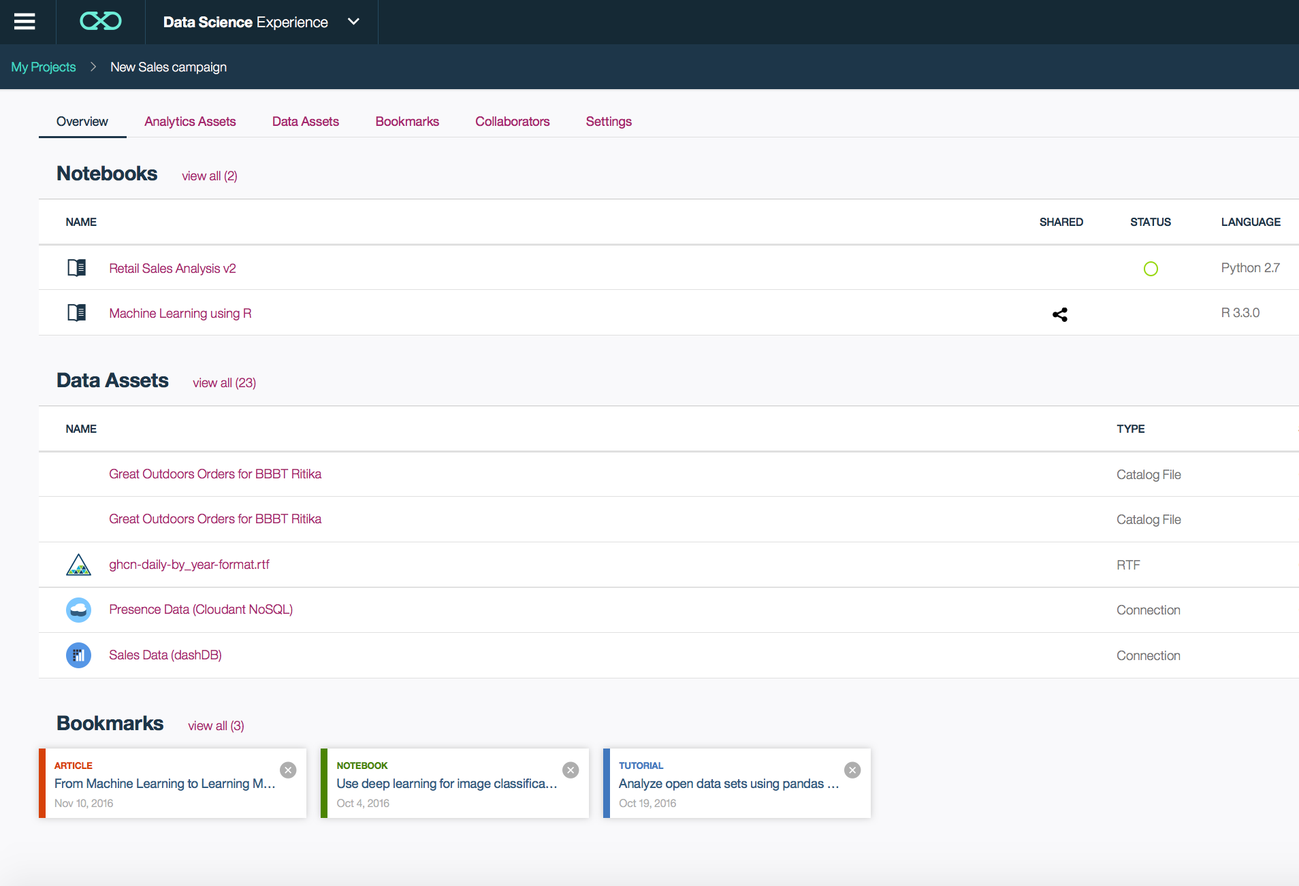
Collaborate Using Projects
Notes:
When working in teams…..
Lets take an example…
- Maybe your BI analyst finds that inspite of a huge marketing campaign Eyewear sales have decreased in the northeast in the last quarter, however, the northeast has also been slammed with storms and doctors offices selling them have been closed for long periods of time…
- so what went wrong? Was the weather indeed affecting your sales? or was your marketing strategy not foolproof? He wants Sadie to investigate more and she builds a model which weights factors of weather, time of year, marketing dollars etc...and she now wants to share this with the marketing folks. She hands it off to a developer who builds a dashboard off this model and presents it to the marketing team. Now all of these people, can work together on this platform. You create a project called Eyewear sales and invite all of these people into your platform.

Slide 13
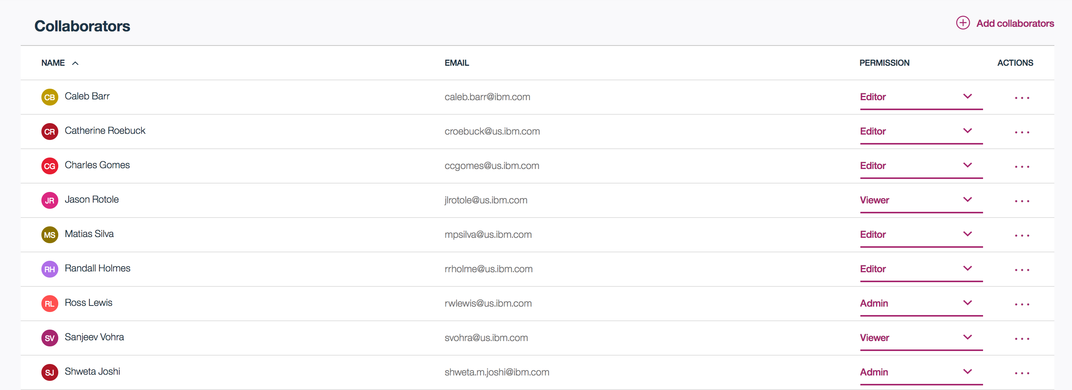
Collaborate

Slide 14
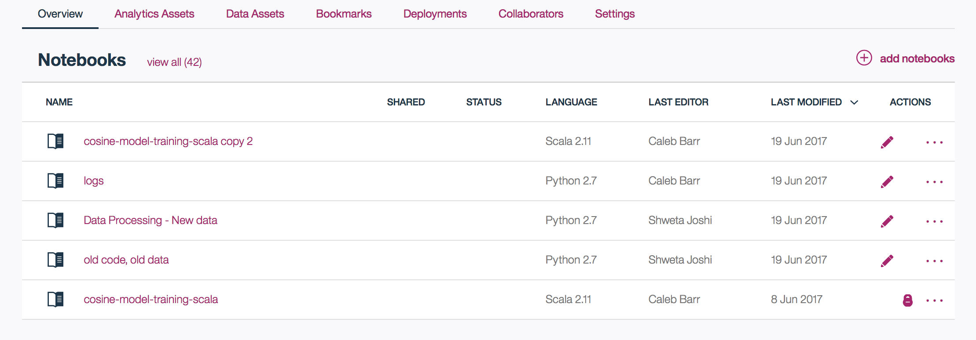
Collaborate
Notes:
Work with teams having diverse skill sets
You will notice a lock on the last NB there…that means...he is working on it and I cannot make changes
....This is a NB environment...which brings us to the next topic....

Slide 15
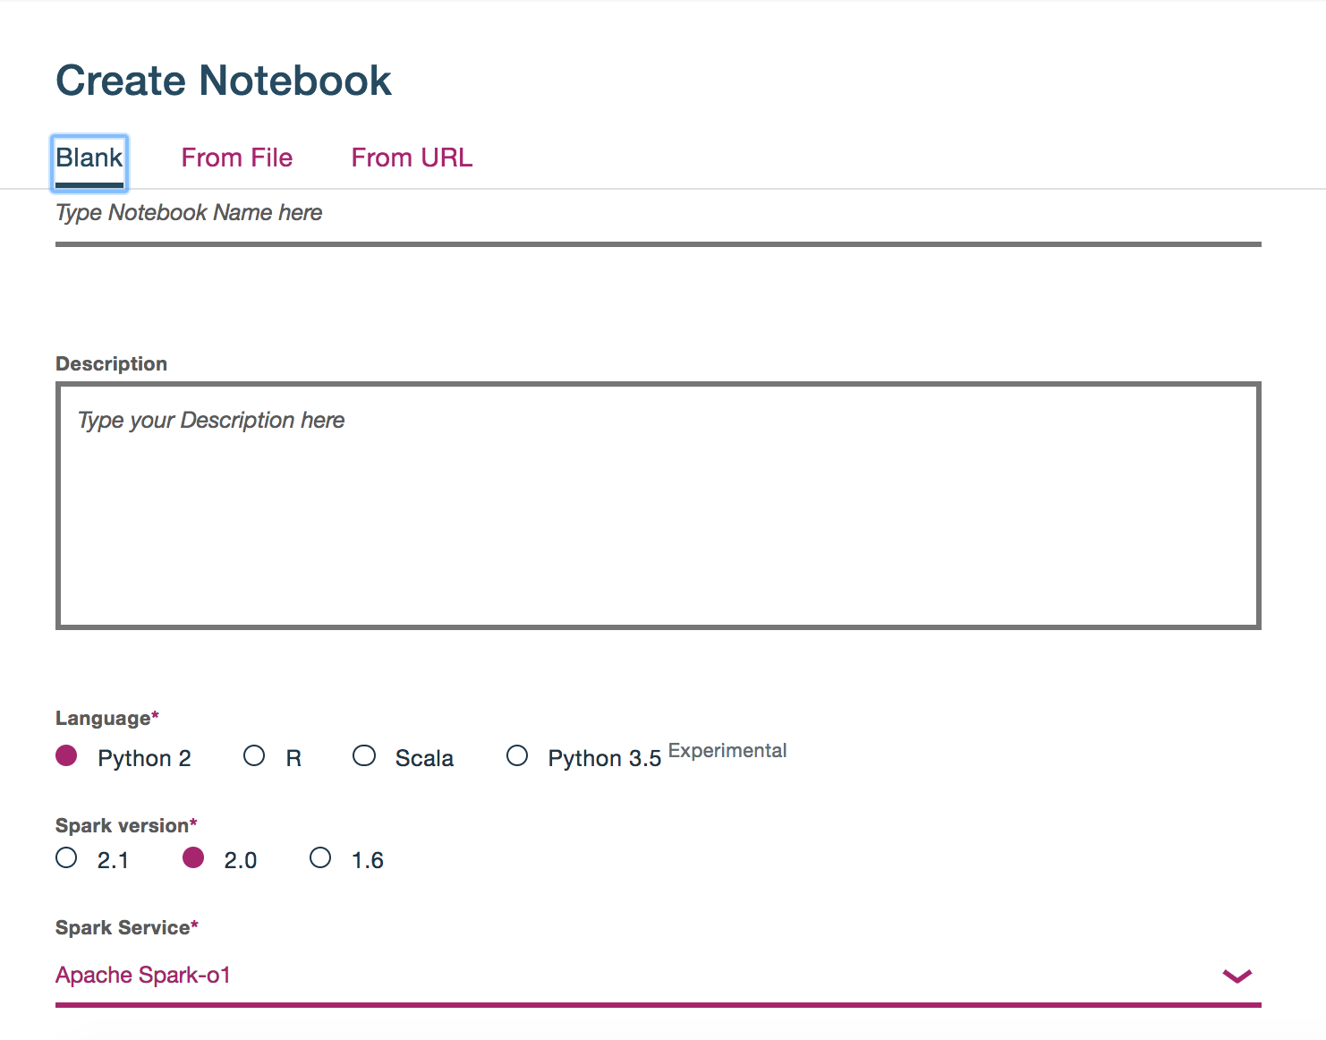
Create
Notes:
You Can create a NB with an environment of your choice….
You will be doing that in a few minutes...
You can see the language options we have....spark versions....and an associated spark service...
In fact, you can associate a 3rd party spark service....

Slide 16
Spark
Notes:
We have talked about spark quite a bit…
Spark is one of the essential components of the platform. Every NB that you create will be associated with a spark service, the service you see here, is the basic 2 node cluster….
And spark is available inside the NB without any additional config.
Now you dont have to know spark, to do stuff in DSX, but it is a very helpful tool if you want to process large amounts of data.
It is friendly programmers and SQL developers, that is it speaks python, Scala, R and Java.
It has a very friendly ML toolkit with also interfaces with scikit-learn….for those of you comfy with that....
In fact, all your hands on labs will be in spark...we will start with the very basic level....

Slide 17

Technology
What is spark?
Why spark?
IBM’s contributions
Spark Internals
Notes:
How many of you are already using spark?
How many of you use jupyter/ rstudio?

Slide 18

Spark is an open source
in-memory application framework for
distributed data processing and
iterative analysis
on massive data volumes
“Analytic Operating System”
Notes:
Spark is an open source project which came out of UC Berkeley’s AMPLAB, now called the “RiseLab”
It is an in memory distributed processing engine
It is designed for heavy workloads
At IBM, we like to call it the “Analytic operating system”
We actually funded the initial Amplab project and continue to fund Riselab

Slide 19
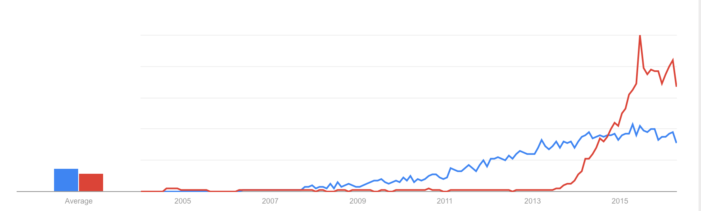
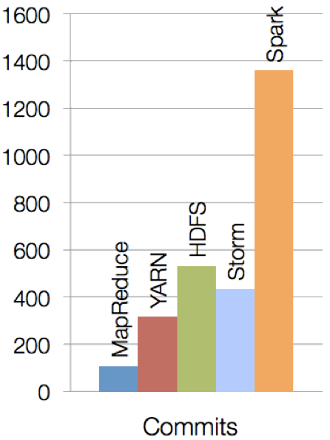
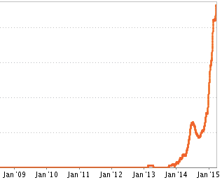
Spark has gained tremendous traction very quickly
Spark is one of the most active open source projects
Hadoop vs Spark (Google Trends)
Spark Job Trends (Indeed.com)
Notes:
It is one of the most active open source projects
In terms of adoption, it has seen a meteoric rise v/s Hadoop which is still enjoying a rise but a steady one
Also reflects in job trends, number of openings which need spark expertise (also on a rise)

Slide 20





Key reasons for interest in Spark
Performant
Productive
In-memory architecture greatly reduces disk I/O
Anywhere from 20-100x faster for common tasks
Concise and expressive syntax, especially compared to prior approaches
Single programming model across a range of use cases and steps in data lifecycle
Integrated with common programming languages – Java, Python, Scala
New tools continually reduce skill barrier for access (e.g. SQL for analysts)
Works well within existing Hadoop ecosystem
Large and growing community of contributors continuously improve full analytics stack and extend capabilities
Leverages existing investments
Improves with age
Notes:
Performant: Fast
Productive: lesser code lines
No wastage….
Extremely popular, code evolves quickly, becomes easier to use by the day...

Slide 21










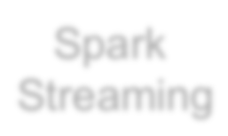
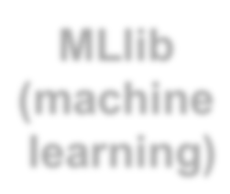

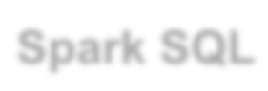







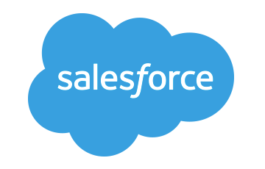








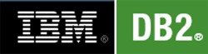



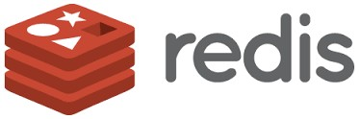
Spark Ecosystem
executes SQL statements
performs streaming analytics using micro-batches
common machine learning and
statistical algorithms
distributed graph processing framework
Execute R
Statistical code against Spark Code
Spark SQL
Spark Streaming
MLlib (machine learning)
GraphX (graph)
SparkR
general compute engine, handles
distributed task dispatching,
scheduling and basic I/O functions
Spark Core Engine
large variety of data sources and formats can be
supported, both on premise or cloud
BigInsights (HDFS)
Cloudant
dashDB
SQL DB
Object Storage
…many others
IBM CLOUD
OTHER CLOUD
CLOUD APPS
ON-PREMISE
Notes:
Spark is completely agnostic to data sources
Bring your data and it will work just fine

Slide 22










Libraries Usage
SparkSQL − 69%
Spark SQL
Spark Streaming
MLlib
Machine Learning
GraphX
Graphing
DataFrames − 62%
Spark Streaming − 58%
MLlib/GraphX − 58%
Spark Core
75% of users use more than one component

Slide 23
Spark Programming Languages
Language | 2014 | 2015 | 2016
Scala | 84% | 71% | 65%
Java | 38% | 31% | 29%
Python | 38% | 58% | 62%
R | unknown | 18% | 20%
Notes:
The hands on lab today will be using pyspark

Slide 24
IBM is all-in on Spark
"It's like Spark just got blessed by the enterprise rabbi."
Contribute to the Core
Launch Spark Technology Cluster (STC), 300 engineers
Open source SystemML
Partner with databricks
Ben Horowitz,
Andreessen Horowitz
Foster Community
Infuse the Portfolio
Educate 1M+ data scientists and engineers via online courses
Sponsor AMPLab, creators and evangelists of Spark
Integrate Spark throughout portfolio
3,500 employees working on Spark-related topics
Spark however customers want it – standalone, platform or products
Notes:
We are all in on spark
We have a center in San Francisco where our engineers are dedicated to contributing to spark, they do not work on any other project
We aim to hire about 300 engineers, we are many 70 as of now
We have also developed and open sourced SystemML which is a machine learning library
We also offer sponser AMPLab where spark was born and we are continuing to invest in RiseLab
There is also free education on big data university for spark and other big data courses
And lastly, spark is a component in a lot of our products and the number is rising, we also offer it on a standalone basis

Slide 25



Spark Tech Center (STC): IBM’s Commitment to Spark
1.5 Years
25,600 Spark LOC
606 Spark JIRAs
253 SystemML JIRAs
64 Speakers at events
… and all that with 1 Team

Slide 26
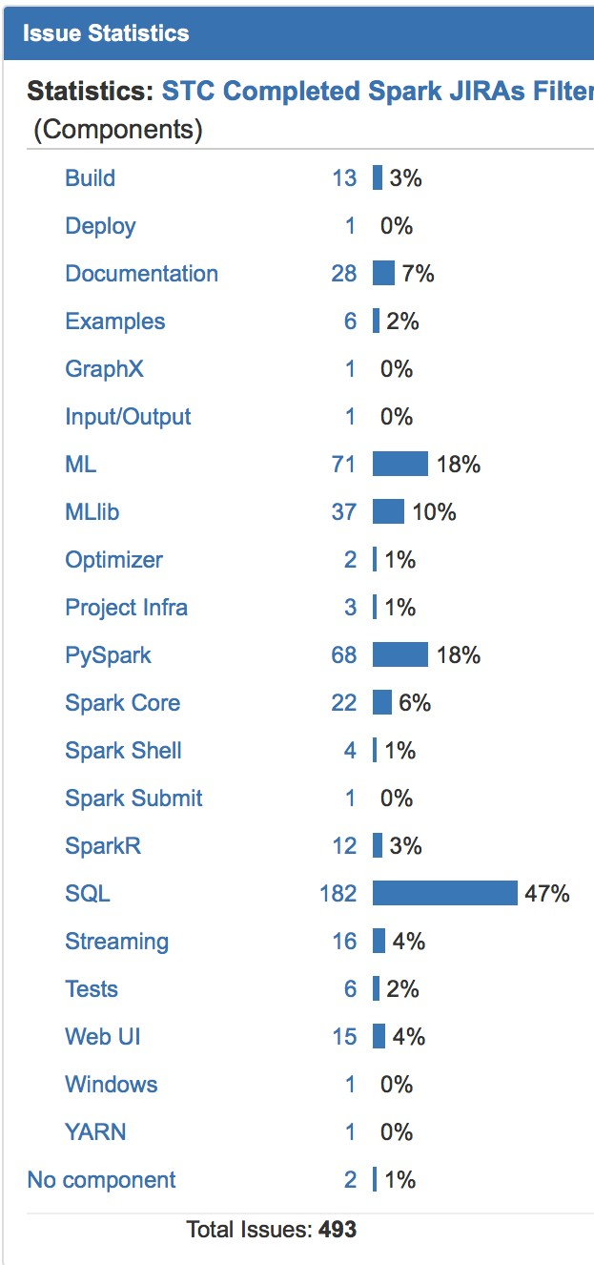
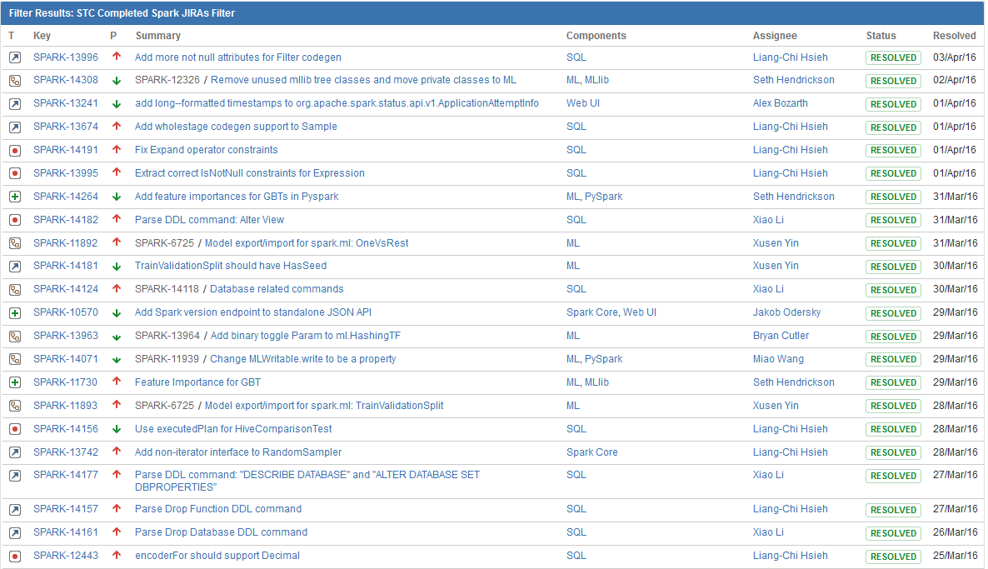
IBM driving SQL and Machine Learning innovation..
http://www.spark.tc/blog/

Slide 27
Comparison of Company Contributions in Spark 2.0
Databricks is active across the board, but especially in Spark SQL
IBM is prominent in every component, but dominates in Spark ML, PySpark and SparkR

Slide 28
Spark Internals
Notes:
Spark is a distributed processing framework

Slide 29
Spark Terminology
Context (Connection):
Represents a connection to the Spark cluster. The Application which initiated the context can submit one or several jobs, sequentially or in parallel, batch or interactively.
Driver (Coordinator agent)
The program or process running the Spark context. Responsible for running jobs over the cluster and converting the App into a set of tasks
Job (Query / Query plan):
A piece of logic (code) which will take some input from HDFS (or the local filesystem), perform some computations (transformations and actions) and write some output back.
Stage (Subplan)
Jobs are divided into stages
Tasks (Sub section)
Each stage is made up of tasks. One task is executed on one partition (of data) by one executor
Executor (Sub agent)
The process responsible for executing a task on a worker node
Notes:
Context – Handle to your cluster, each application will have its own context. At a given point of time, there can be several contexts on a cluster
Driver – Works hand in hand with the context, it is a program which runs on the master node and is responsible for generating an execution plan
Job – a single piece of code which you will submit to the cluster (and this job will be divided by the driver into smaller pieces to be run on worker nodes)
Stage – a part of the job
Tasks - the most atomic piece of code, this runs on the worker nodes, each worker node will have a single task for the given job.

Slide 30
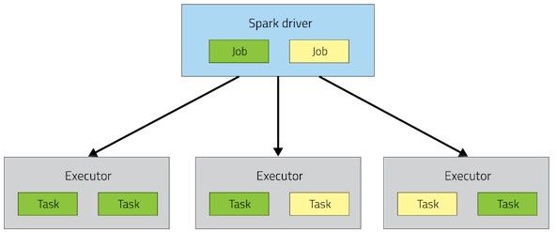
Spark Architecture
Application

Slide 31
A Spark application is initiated from a driver program
Each Spark application runs as a set of processes coordinated by the Spark context object (driver program)
– Spark context connects to Cluster Manager (standalone, Mesos/Yarn)
Spark context acquires executors (JVM instance) on worker nodes
Spark context sends tasks to the executors
Worker Node
Executor
Cache
Task
Task
Driver Program
Cluster Manager
App
SparkContext
Worker Node
Executor
Cache
Task
Task

Slide 32
Resilient Distributed Datasets
RDD is a distributed collection of Scala/Python/Java objects of the same type:
Strings
Integers
(key, value) pairs
class Java/Python/Scala objects
RDDs are immutable
Modifications create new RDDs
Physically distributed across cluster, but manipulated as one logical entity:
Spark will “distribute” any required processing to all partitions where the RDD exists and perform necessary redistributions and aggregations as well.
Example: Consider a distributed RDD “Names” made of names
Partition 1
Partition 2
Partition 3
Names
Mokhtar Jacques Dirk
Cindy Dan Susan
Dirk Frank Jacques
Notes:
Primary data type in Spark
It is a basic unit of computation…. Just as a database holds tables...and those tables can then contain data of different types, an RDD is a unit which contains data in the spark world.

Slide 33
Resilient Distributed Datasets
Suppose we want to know the number of names in the RDD “Names”
User simply requests: Names.count()
Spark will “distribute” count processing to all partitions so as to obtain:
Partition 1: Mokhtar(1), Jacques (1), Dirk (1) è 3
Partition 2: Cindy (1), Dan (1), Susan (1) è 3
Partition 3: Dirk (1), Frank (1), Jacques (1) è 3
Local counts are subsequently aggregated: 3+3+3=9
To lookup the first element in the RDD: Names.first()
To display all elements of the RDD: Names.collect() (careful with this)
Names Partition 2
Partition 1
Partition 3
Mokhtar Jacques Dirk
Cindy Dan Susan
Dirk Frank Jacques

Slide 34
RDDs
Two types of operations
Transformations
Actions
Fault tolerance
If data in memory is lost it will be recreated from lineage

Slide 35
Code Execution (1)
// Create RDD
val quotes = sc.textFile("hdfs:/sparkdata/sparkQuotes.txt")
// Transformations
val danQuotes = quotes.filter(_.startsWith("DAN"))
val danSpark = danQuotes.map(_.split(" ")).map(x => x(1))
// Action
danSpark.filter(_.contains("Spark")).count()
// Create RDD
val quotes = sc.textFile("hdfs:/sparkdata/sparkQuotes.txt")
// Transformations
val danQuotes = quotes.filter(_.startsWith("DAN"))
val danSpark = danQuotes.map(_.split(" ")).map(x => x(1))
// Action danSpark.filter(_.contains("Spark")).count()
File: sparkQuotes.txt
DAN Spark is cool BOB Spark is fun
BRIAN Spark is great DAN Scala is awesome BOB Scala is flexible

Slide 36
Code Execution (2)
// Create RDD
val quotes = sc.textFile("hdfs:/sparkdata/sparkQuotes.txt")
// Transformations
val danQuotes = quotes.filter(_.startsWith("DAN"))
val danSpark = danQuotes.map(_.split(" ")).map(x => x(1))
// Action
danSpark.filter(_.contains("Spark")).count()
File: sparkQuotes.txt
RDD: quotes
DAN Spark is cool BOB Spark is fun
BRIAN Spark is great DAN Scala is awesome BOB Scala is flexible

Slide 37
Code Execution (3)
// Create RDD
val quotes = sc.textFile("hdfs:/sparkdata/sparkQuotes.txt")
// Transformations
val danQuotes = quotes.filter(_.startsWith("DAN"))
val danSpark = danQuotes.map(_.split(" ")).map(x => x(1))
// Action
danSpark.filter(_.contains("Spark")).count()
File: sparkQuotes.txt
RDD: quotes
RDD: danQuotes
DAN Spark is cool BOB Spark is fun
BRIAN Spark is great DAN Scala is awesome BOB Scala is flexible

Slide 38
Code Execution (5)
// Create RDD
val quotes = sc.textFile("hdfs:/sparkdata/sparkQuotes.txt")
// Transformations
val danQuotes = quotes.filter(_.startsWith("DAN"))
val danSpark = danQuotes.map(_.split(" ")).map(x => x(1))
// Action
danSpark.filter(_.contains("Spark")).count()
File: sparkQuotes.txt
RDD: quotes
RDD: danQuotes
RDD: danSpark
DAN Spark is cool BOB Spark is fun
BRIAN Spark is great DAN Scala is awesome BOB Scala is flexible

Slide 39
Code Execution (5)
// Create RDD
val quotes = sc.textFile("hdfs:/sparkdata/sparkQuotes.txt")
// Transformations
val danQuotes = quotes.filter(_.startsWith("DAN"))
val danSpark = danQuotes.map(_.split(" ")).map(x => x(1))
// Action
danSpark.filter(_.contains("Spark")).count()
File: sparkQuotes.txt
RDD: quotes
RDD: danQuotes
RDD: danSpark
DAN Spark is cool BOB Spark is fun
BRIAN Spark is great DAN Scala is awesome BOB Scala is flexible
DAN Spark is cool BOB Spark is fun
BRIAN Spark is great DAN Scala is awesome BOB Scala is flexible
DAN Spark is cool DAN Scala is awesome
Spark Scala
1

Slide 40
Hands on Labs

Slide 41
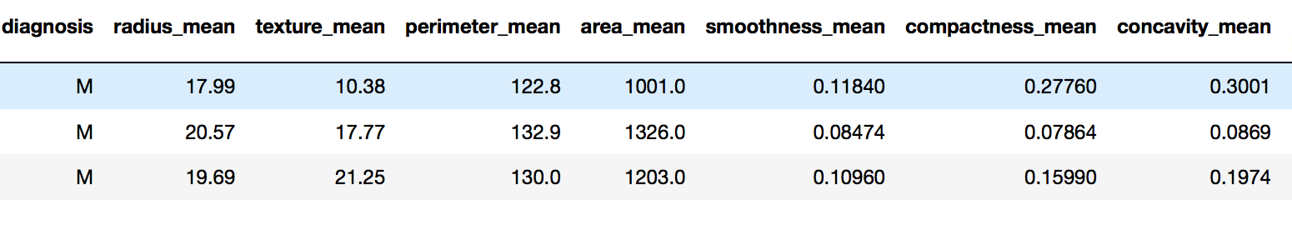
DataFrames
Similar to Pandas DataFrames
Same principles as an RDD
All spark libraries can now handle DataFrames

Slide 42
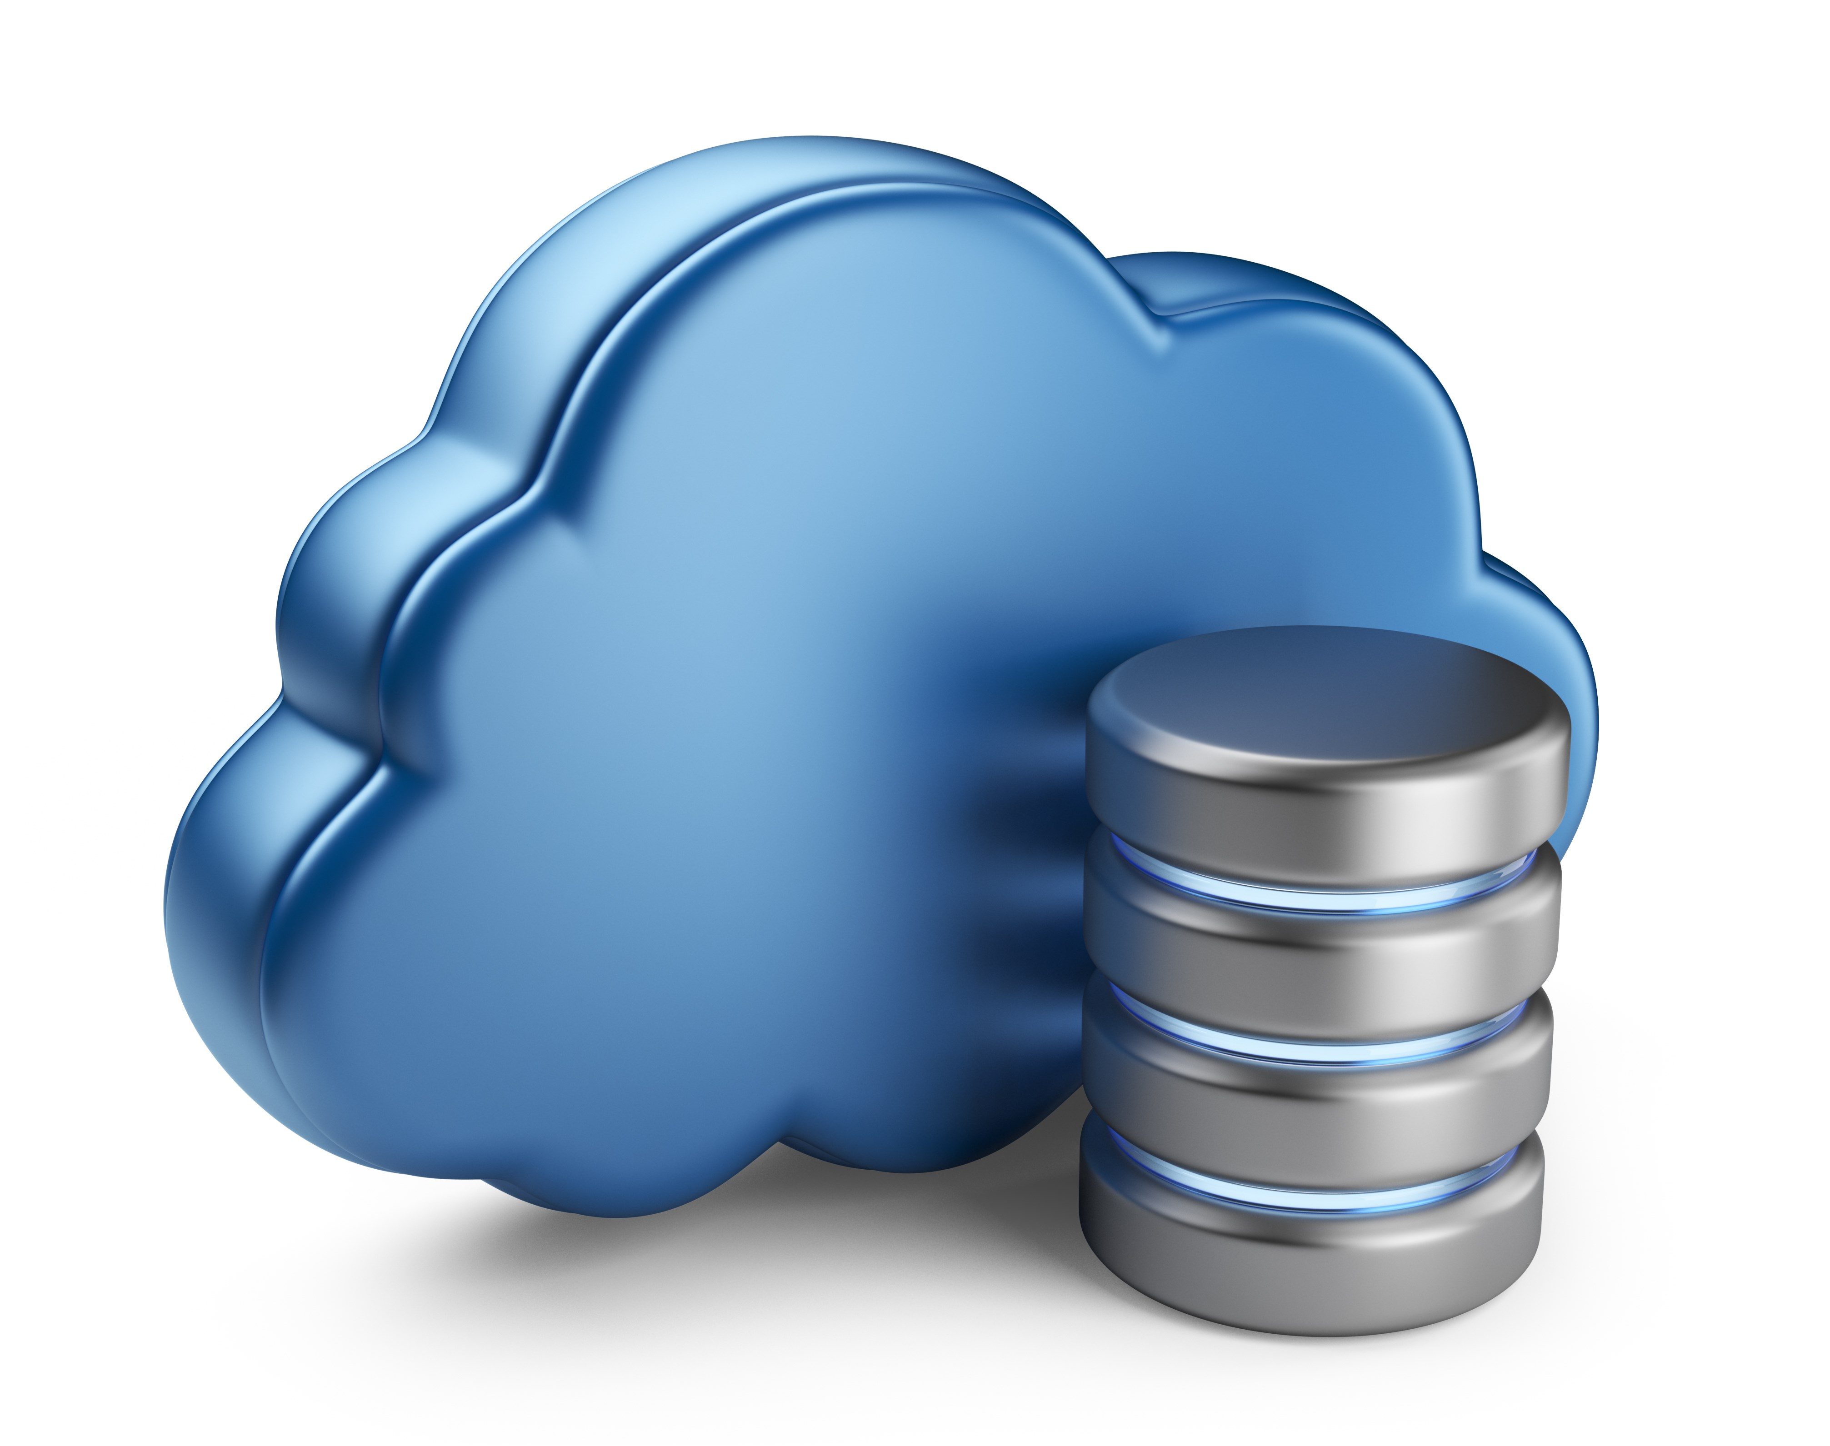






Sample Architecture
Source / Backend
Application development
Deployment
Scheduler
GitHub
Monitoring Dashboard
Maintenance / Updates

Slide 43
Hands - on Labs https://github.com/joshishwetha/dsx-spark

